Slide 1
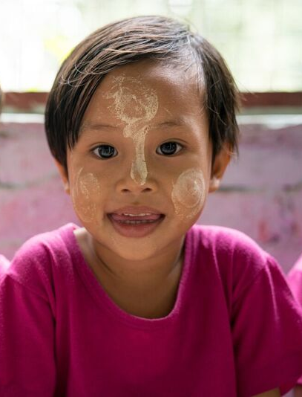
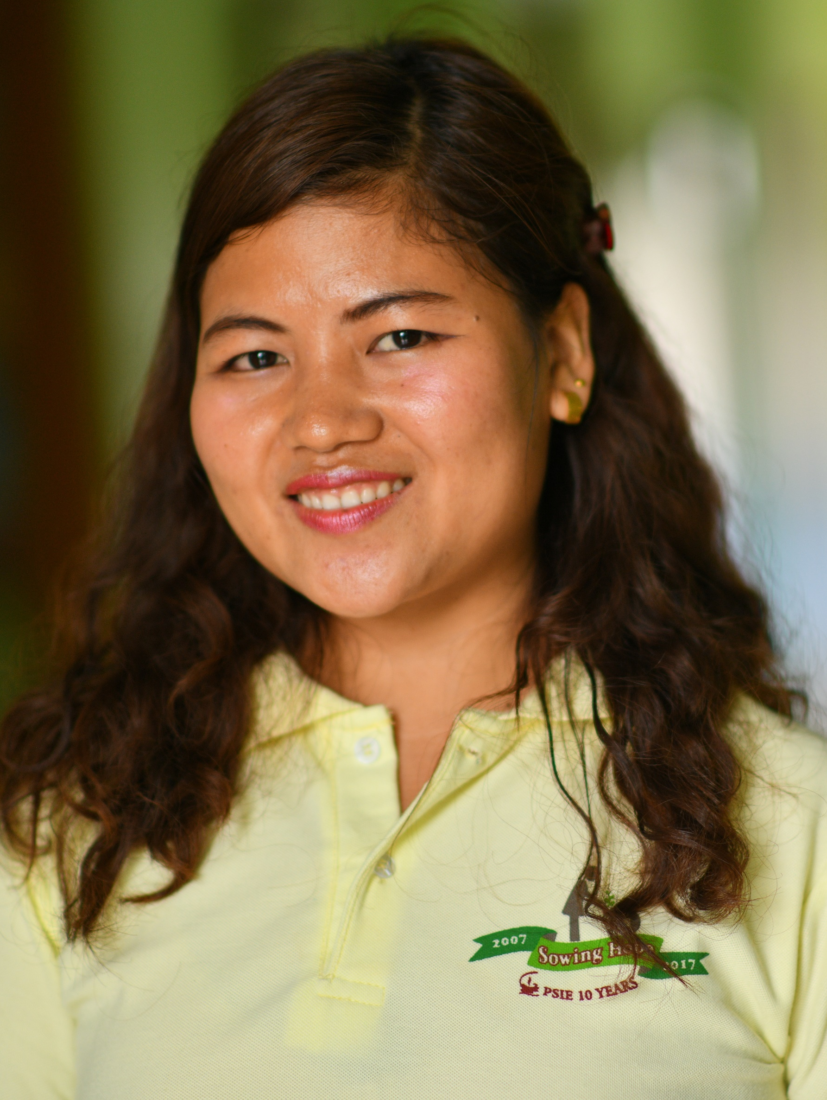
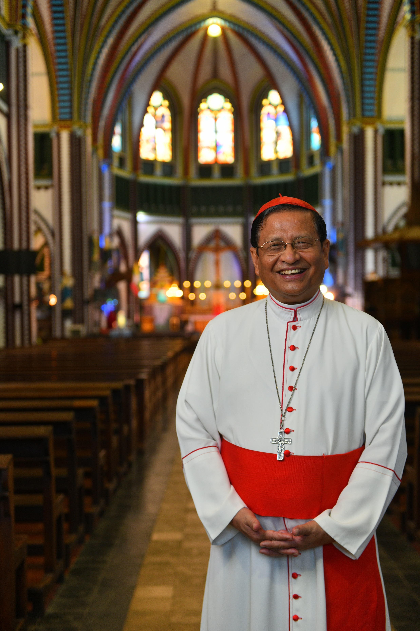






Notes:
At age 12, Min Min and her siblings had lost both their parents and were taken in by their local parish priest.
After an early childhood moving from village to village, gaining an education was difficult. Min Min recognises the benefit of providing children a quality education.
Min Min moved to Yangon to complete her education after Year 1.
Returning to her rural village after finishing school, Min Min was volunteering at a school the parish had set up for local children.
This is where she discovered her love of teaching. Through the teachers at the school, Min Min joined the Pyinya Sanyae Institute of Education (PSIE), where she is currently studying to become a teacher and gain her Diploma of Education.
After her graduation from PSIE, Min Min hopes to go out to rural communities where she can help support children that may not otherwise have a chance to receive a education.

Slide 2
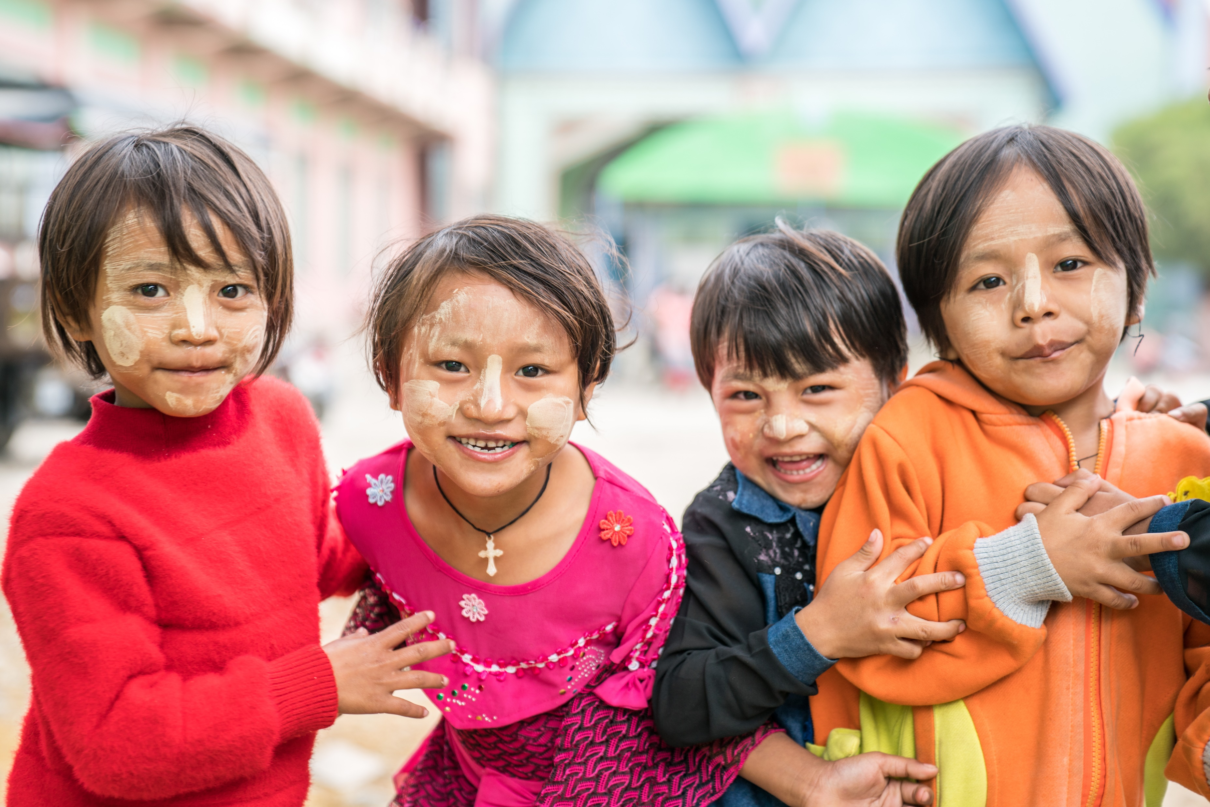
Notes:
Thank you for your support!

Slide 3
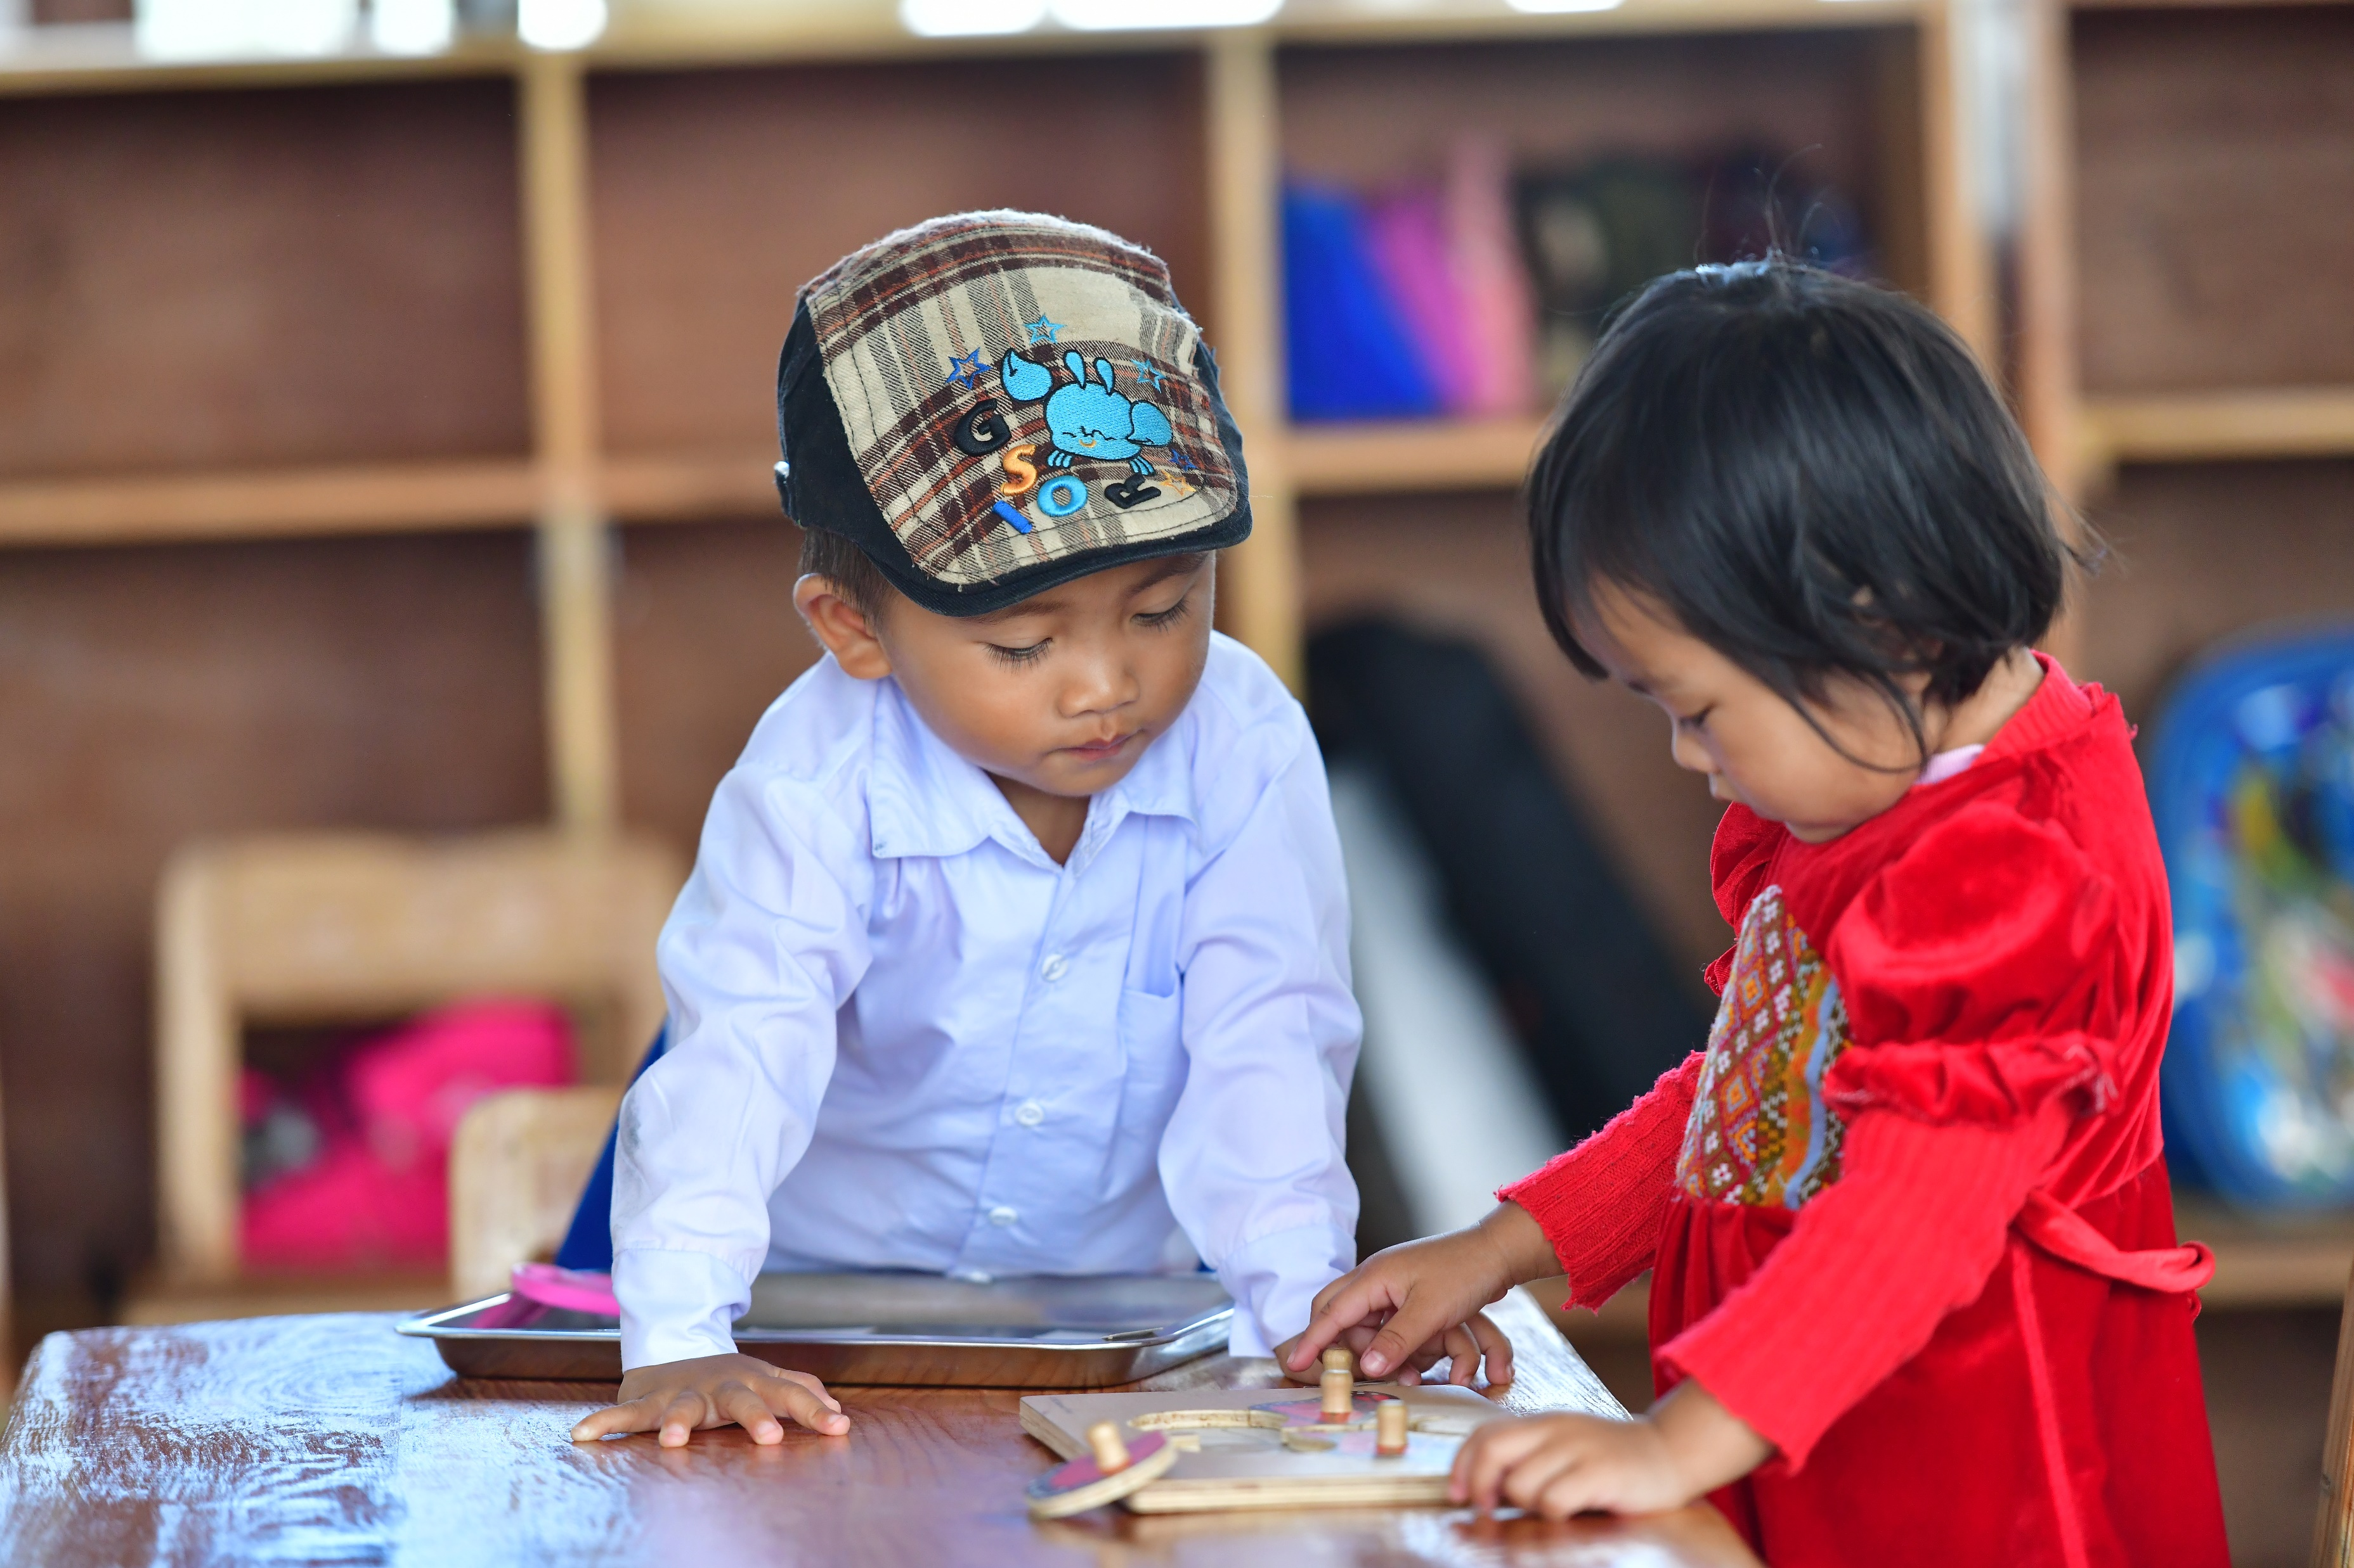
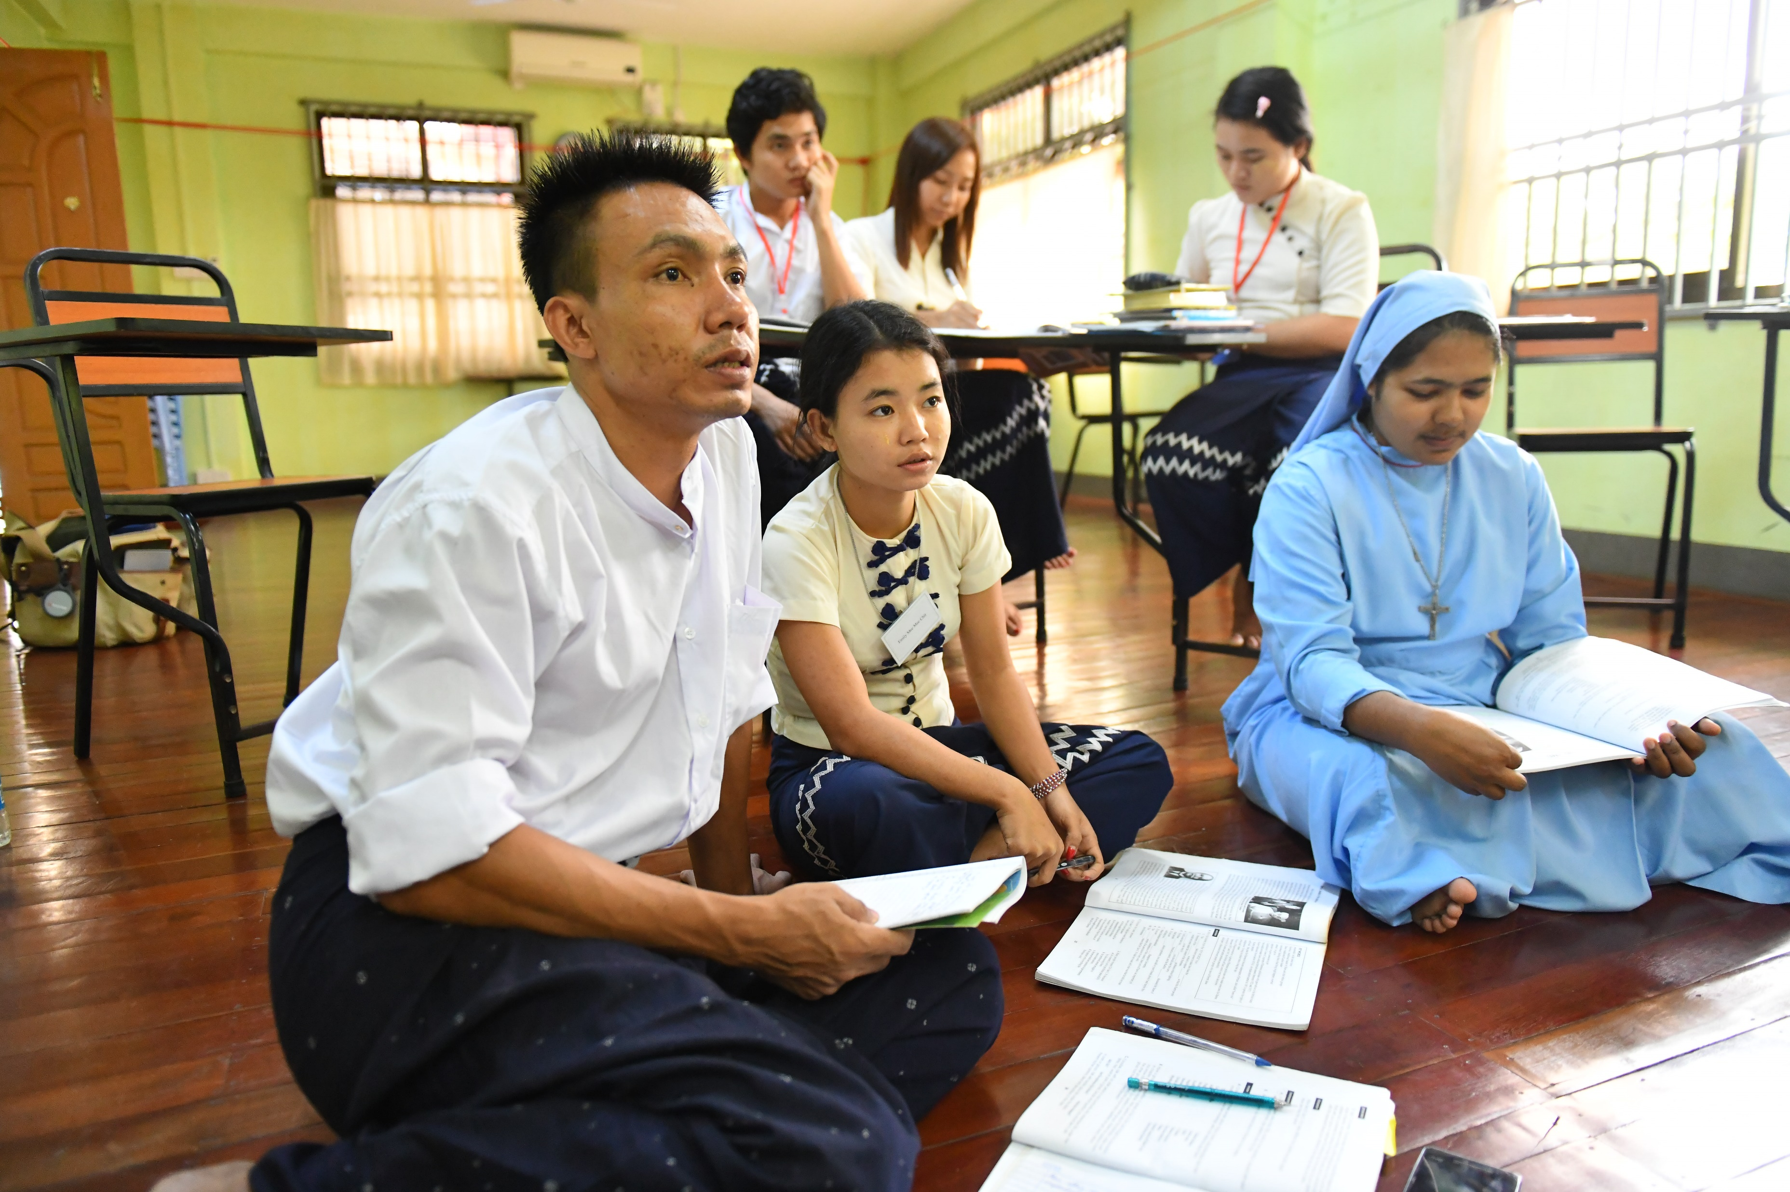

Needs of Myanmar
Teacher training through PSIE
Training young men and women with child-centred methodology to go out to rural communities and support children in need.
Educational resources such as textbooks, staff costs of the teachers, living costs for the students who come from different regions.
Supporting schools
Ensuring children, especially in rural areas of Myanmar, are able to access quality education.
Giving children access to educational resources such as books, teaching aid materials like puzzles and blocks.
Notes:
Extra Slide

Slide 4
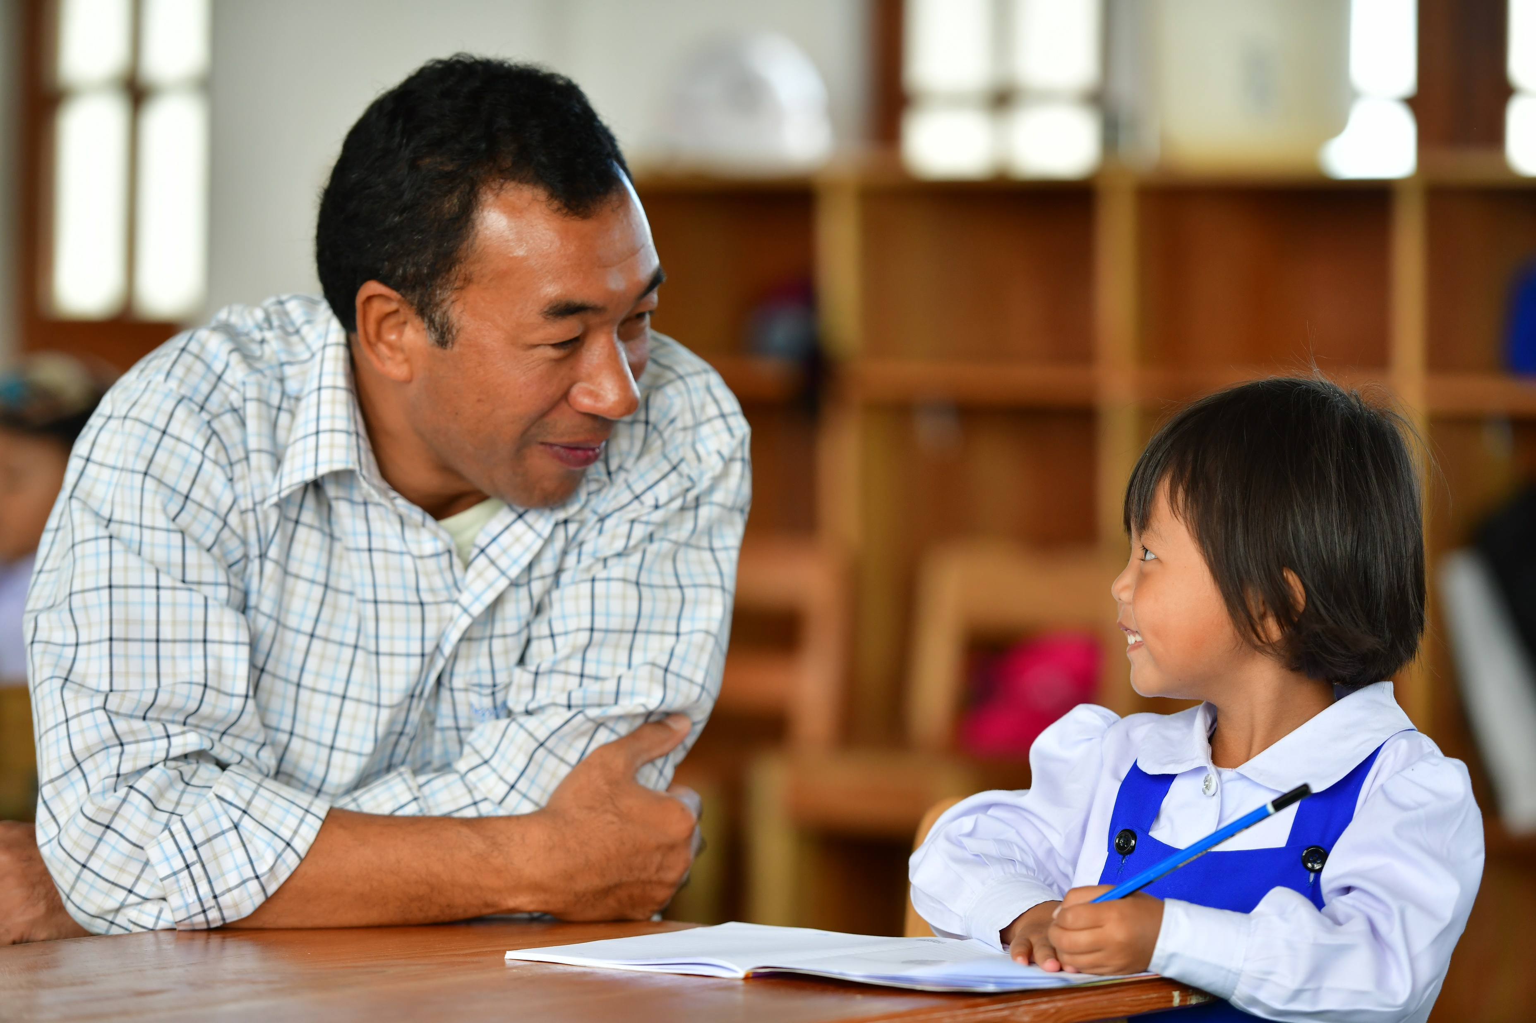
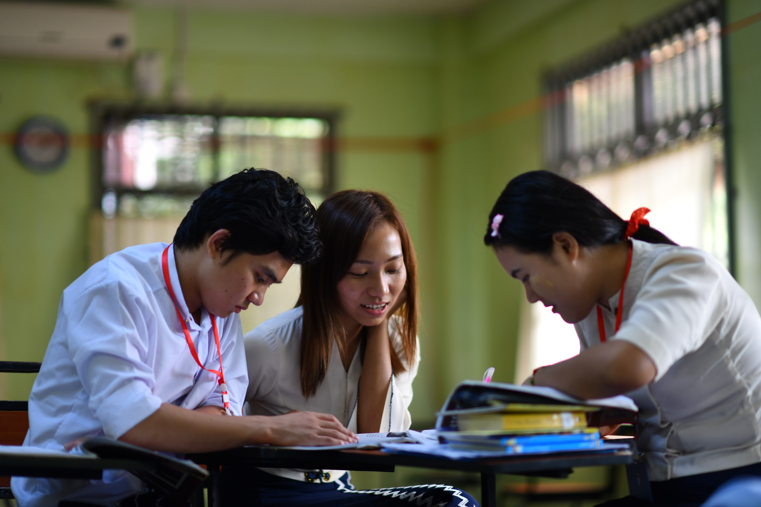
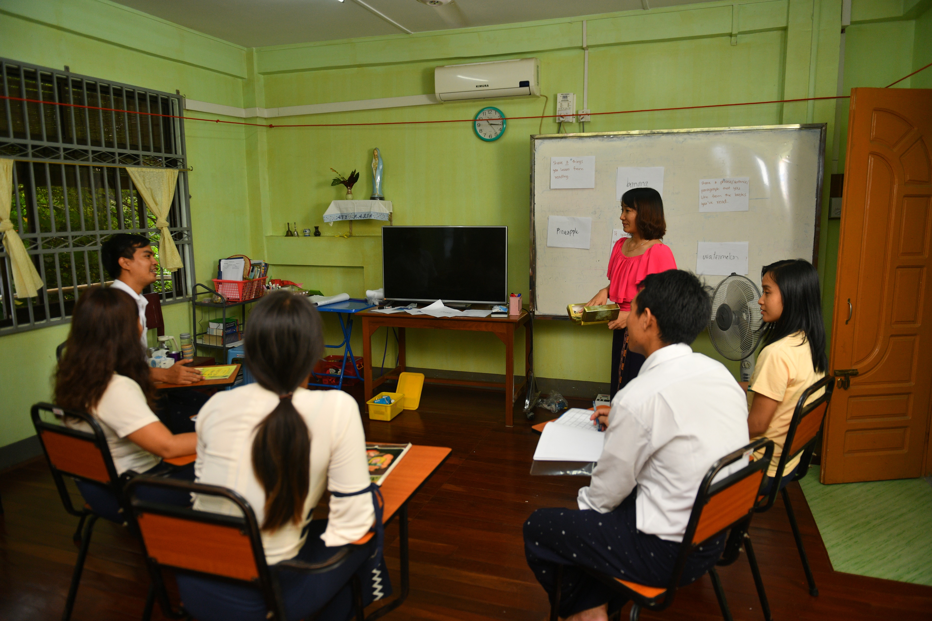
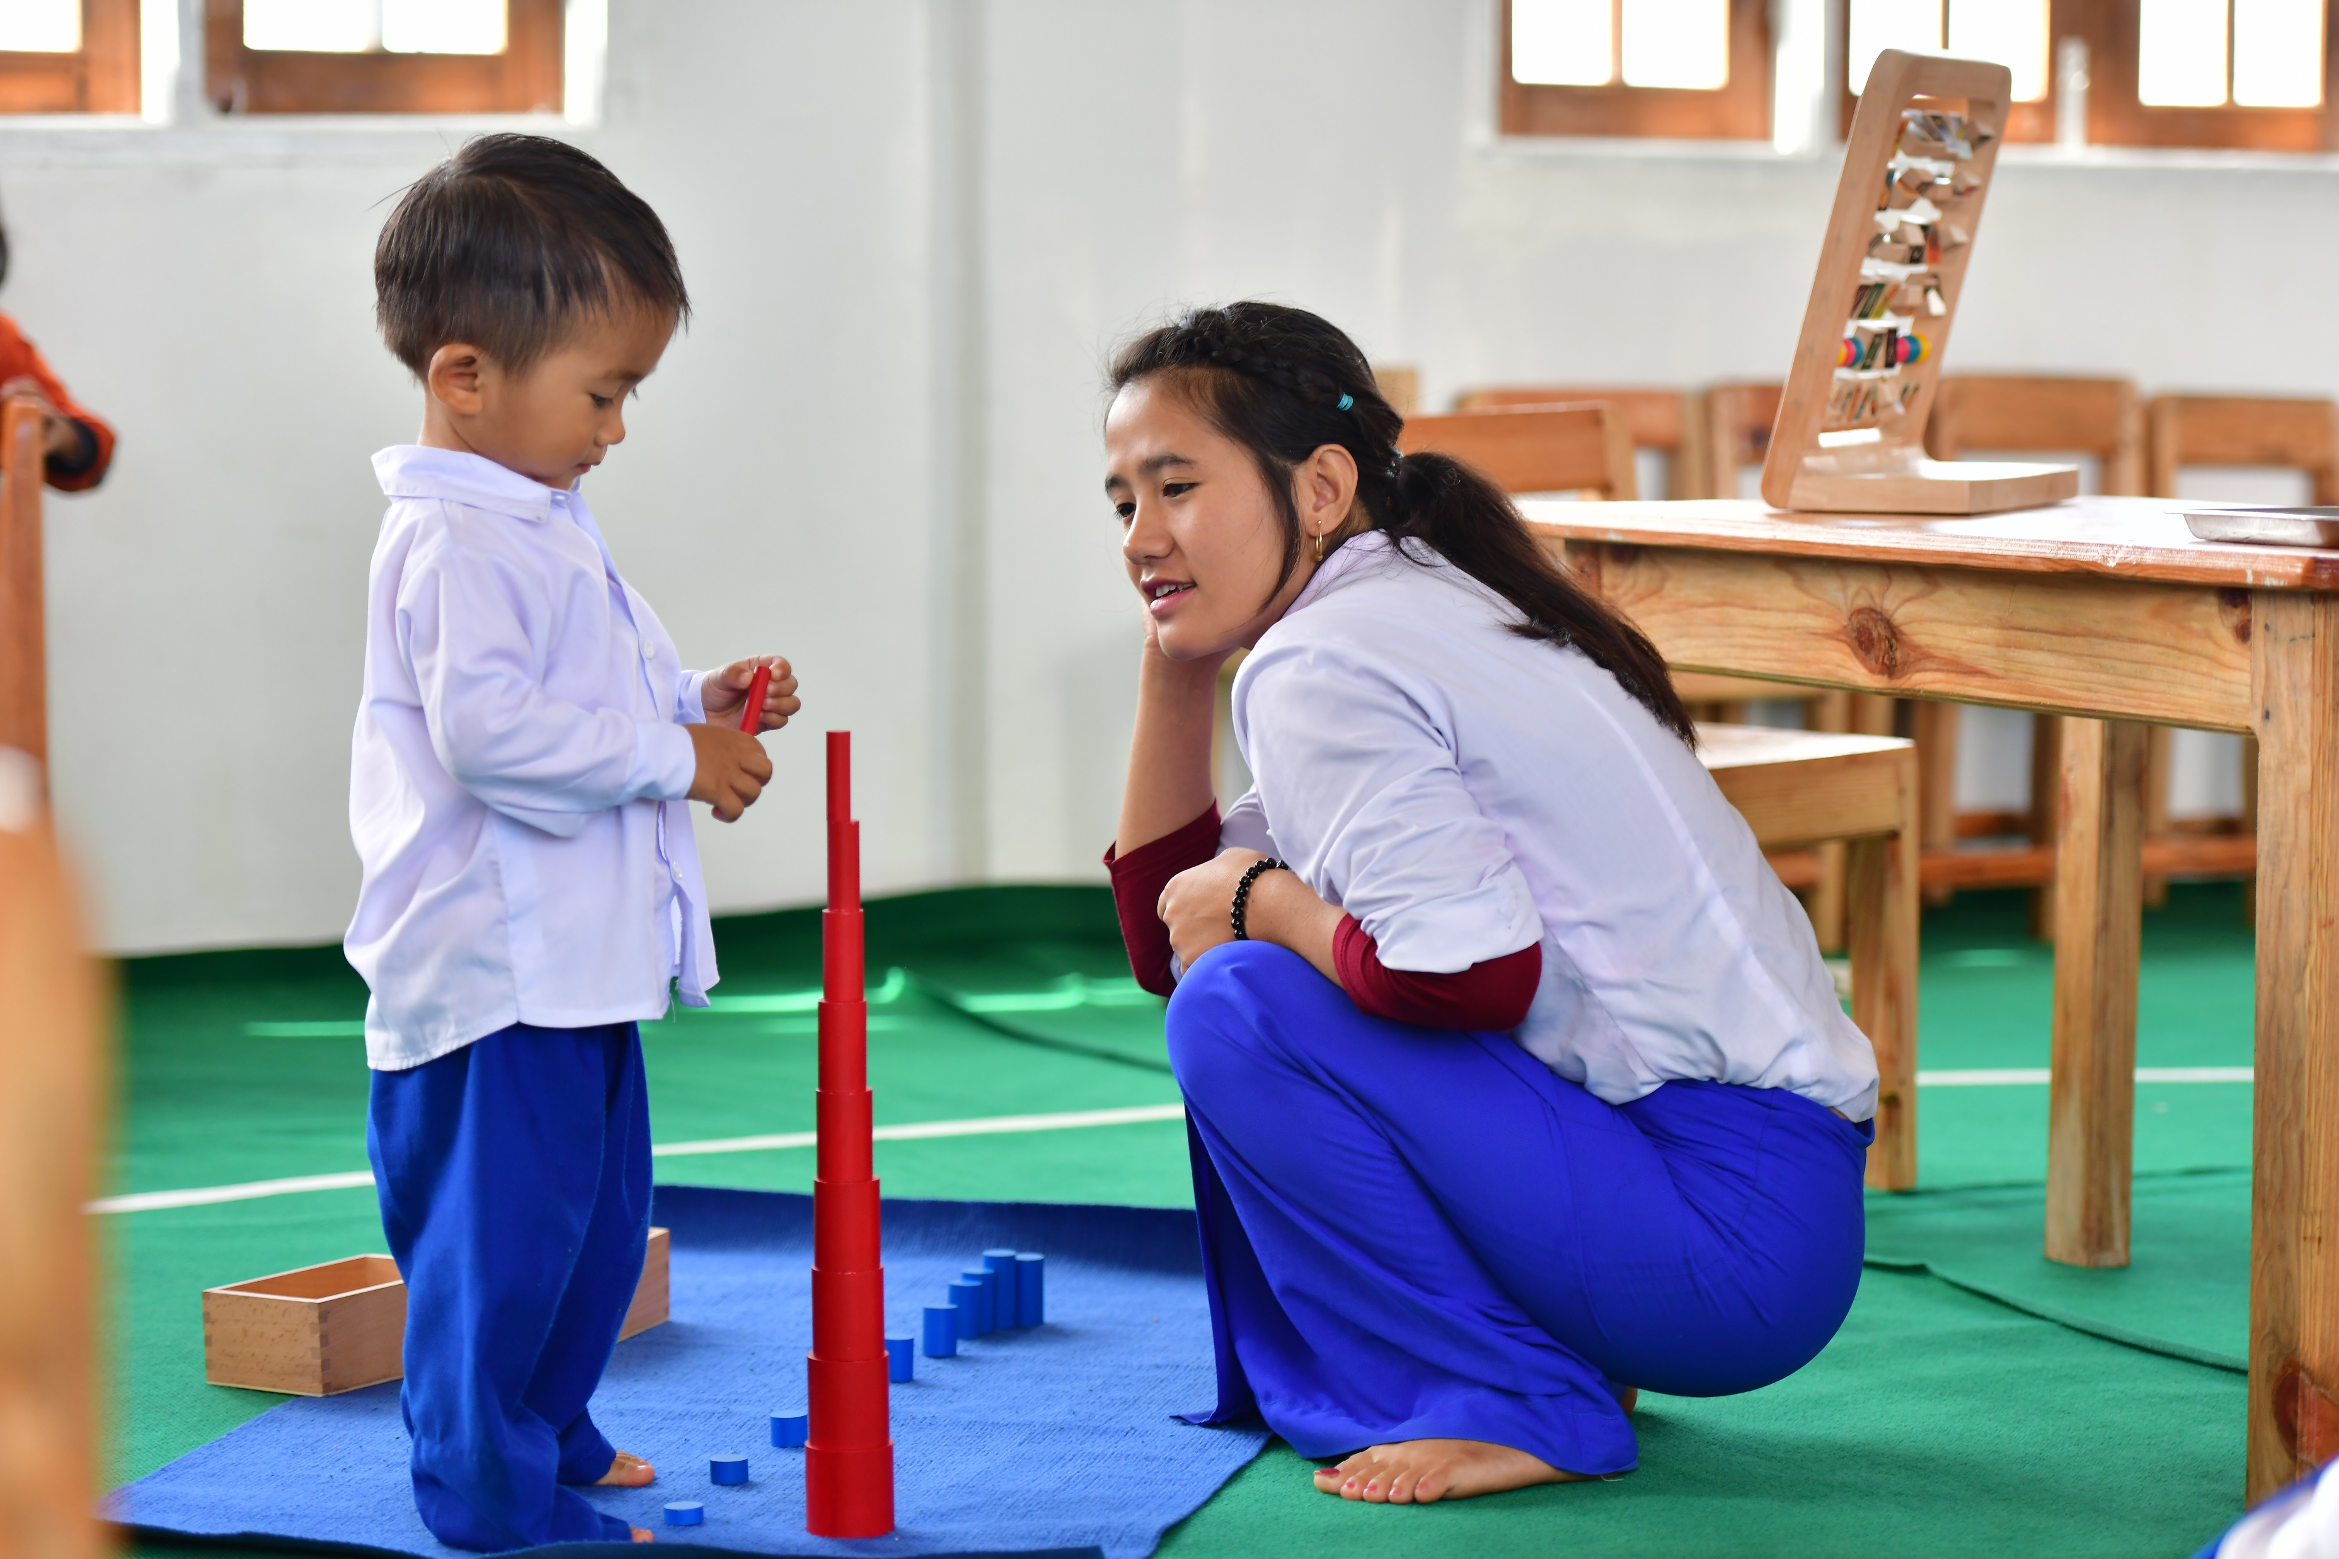
Notes:
Extra Slide

Slide 5

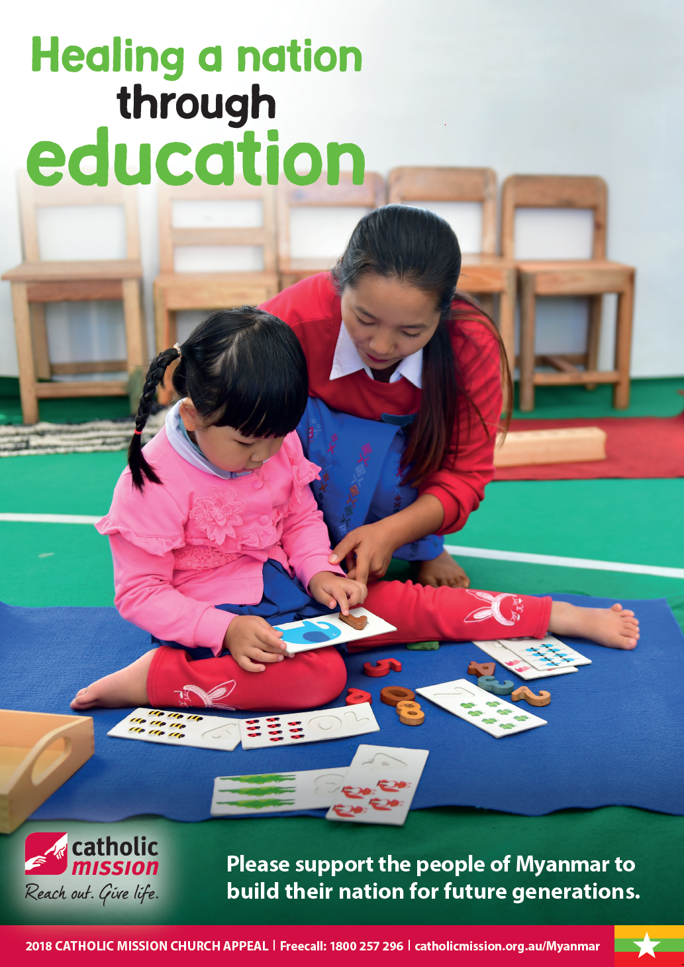
2018 Catholic Mission Church Appeal - Myanmar
‘How beautiful upon the mountains are the feet of the messenger who announces peace, who brings good news…’ – Isaiah 52:7
Notes:
Spare Slide

